Slide 1
COVID-19 Response
Leadership Update
Updated May 24, 2021

Slide 2
Global and National Data
Global Reported Cases:
Global cases – 166,814,851 Global Deaths –3,458,905 (WHO)
Global cases – 167,243,444 Global Deaths –3,465,348 (JHU) Global Vaccine Doses Administered –1,673,606,181 (JHU) Doses Administered in the US –284,948,228 (JHU)
Cases within the US:
Total cases –32,933,337 Total Deaths –586,793 (CDC)
Cases within Colorado:
Total cases – 537,401
Hospitalized – 29,790
Total Tested – 3,028,653
COVID-19 deaths – 6,632
Outbreaks – 5,344
Notes:
https://covid19.who.int/table
https://coronavirus.jhu.edu/map.html
https://covid.cdc.gov/covid-data-tracker/#cases_casesper100klast7days
Https://covid19.colorado.gov/data

Slide 3
Hospital Data
Denver Health COVID-19 Cases:
19 patient cases
Current location: 9A(8); MICU (6); Peds (1); 3B FLX-PCU (3): SICU (1)
1 Persons Under Investigation (PUI’s)
2 discharge yesterday / 2,298 total discharges
2 Admission yesterday / 2,384 total COVID-19 admissions
Colorado Hospital Totals:
Statewide # COVID-19 PUIs – 48
Statewide # COVID-19-Confirmed – 499
Statewide ICU Bed Availability (current) – 317
Statewide Med/Surgical Bed Availability (current) – 2,167
Notes:
Updated as of 5/24

Slide 4
Notes:
Updated as of 5/24

Slide 5
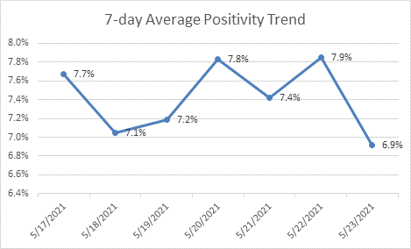
COVID-19 Lab Testing Updates
Date | Total Tests Resulted | Total Positive | Daily Positivity Rate
5/17/2021 | 271 | 28 | 10.3%
5/18/2021 | 391 | 21 | 5.4%
5/19/2021 | 227 | 17 | 7.5%
5/20/2021 | 316 | 32 | 10.1%
5/21/2021 | 256 | 9 | 3.5%
5/22/2021 | 252 | 23 | 9.1%
5/23/2021 | 163 | 4 | 2.5%

Slide 6
REMINDER: New Inpatient Visitor Guidelines go into effect on Tuesday, 6/1/21
Informed and developed by key stakeholders, there are two changes to the guidelines:
The visitor allowance for non-COVID patients on our Adult Acute/Critical Care Units will increase from 1 visitor / day to 2 visitors
The “end of life” exception was revised to empower a patient’s care team to make case-by-case decisions about additional visitor allowances (e.g. allowing more visitors, expanding visiting hours. Etc.) for patients who are:
Near or at End of Life /Comfort Care OR have a Critical Illness or Injury with a high likelihood of dying within 48 hours

Slide 7
Weekly Vaccine Updates
Continued partnership with Logistics, Planning, and Operations for managing inventory and appointments
Augmenting Pfizer capacity to support pediatric population administration (12 y.o.+)
Maintaining awareness of vaccine inventory and expiration dates
Ensure a first-in-first-out methodology
Aim for no wasted doses!
Epic Updates
Options for vaccine card replacement
On the After Visit Summary
BPA for co-administration of other vaccines
Continued planning for vaccinations to be embedded into normal operations at ACS clinic locations
Last clinic day in Pav M is Thursday, May 27, 2021

Slide 8
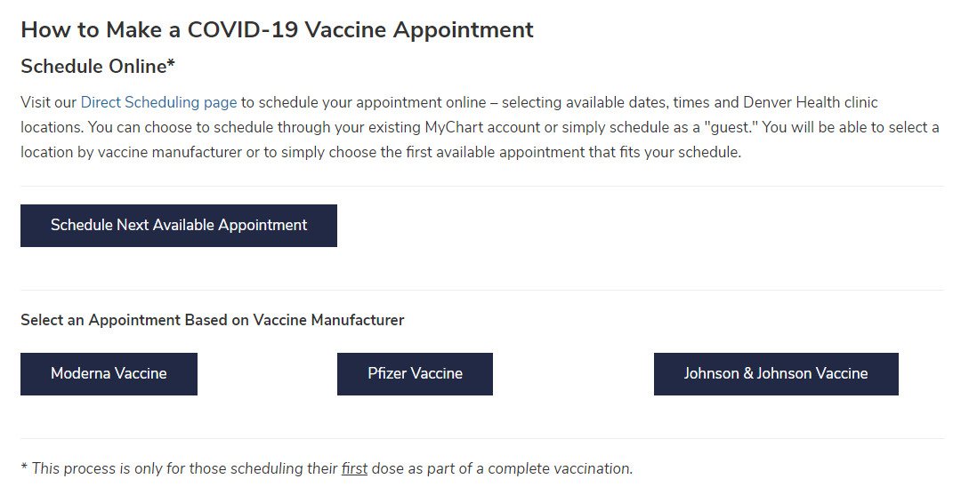
Open Scheduling
https://www.denverhealth.org/patients-visitors/coronavirus/covid-19-vaccination

Slide 9
Vaccine Inventory Week of May 19 to May 25, 2021
Vaccine | Doses Requested | Doses Received | Total Capacity | Clinic Capacity – if staffed | First Dose Capacity | Special Event Capacity
Pfizer | 1,170 | 0 | 2,590 | 2,070 | 1,097 | 520
Moderna | 6,100 | 0 | 9,490 | 8,490 | 5,226 | 1,000
Johnson & Johnson | 0 | 0 | 1,500 | 1,500 | 0 | 1,500
Header | Definition
Doses requested | Quantity we order
Doses received | Quantity we are allocated
Total capacity | Capacity including DH clinics and special events (e.g. DPS clinics, CCC, LMV) – reflects all the events we order vaccine for
Clinic Capacity – if staffed | This is just DH regular clinic capacity. It does not include special events
First dose capacity | Quantity for first dose administration
Special event capacity | Vaccine ordered for events outside of on-campus and ACS clinics (i.e. CCC)

Slide 10
Last 7-Day Vaccinations Weekly Update
First Doses | Second Doses
2,641 | 5,409
Notes:
Updated 5/24

Slide 11
Total Doses Administered
First Doses | Second Doses
103,747 | 87,337
Notes:
Updated 5/24

Slide 13
Notes:
Doses administered by HMM

Slide 14
Administration
Group | First Dose | Second Dose | Target
High Risk Condition | 21,607 | 18,937 | 109,233*
Age 60-69 | 14,755 | 14,024 | 25,279**
Age 70+ | 15,184 | 14,777 | 22,262**
Community Healthcare Workers | 13,870 | 12,989 | 3,437**
1B.2 Other | 194 | 182
Denver Health Staff | 7,284 | 7,129 | 9,807^
ECE-12th Grade Teachers | 4,149 | 4,072 | 18,000+
First Responders | 3,317 | 3,251 | 3,300
1B.3 - Agriculture & Grocery Store Workers | 1,799 | 1,684 | 2,035*
1B.4 - 50-59 y.o. | 13,748 | 12,608 | 5,949*
Phase 2 – General Public | 19,953 | 15,409
Other | 5,608 | 1,942
*Active and empaneled patients
*DHHA Patients and those Identified through the Vaccine Interest Request Form.
+ Total DPS Educators. We are working closely with DPS to schedule and vaccinate educators
^ Employees and Residents – New hires, contractors, volunteers, etc. make this a moving target
Notes:
Moving target… as interest in vaccine grows and additional groups are included in the “eligible” criteria, then our numbers will continue to grow
Non-Denver Health patients and interested individuals will frequently have signed themselves up on multiple vaccine interest lists throughout greater Denver (UCH, DH, SCL, Centura, HCA), so identifying a true “still interested” denominator as more and more people complete their vaccinations at different healthcare systems throughout the city and county of Denver will be difficult.
OTHER – does not have a modifier on it in Epic

Slide 15
Clinics
Pav M 2nd Floor
ACS Outreach Clinics: Lowry, Pena, Westside
SBHC Clinics
ACS Primary Clinics
ACS Drive-Thru Clinics
Mobile Health Clinics
Urgent Care Clinics
DH Immunization Clinic
Winter Park Medical Center
Montbello High School
Other Community Partnership Events

Slide 16
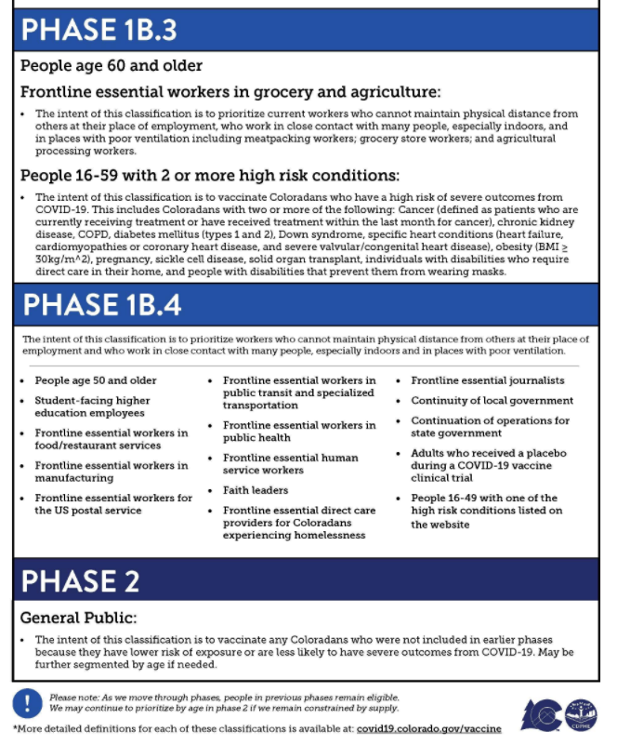
Notes:
Governor’s COVID-19 Vaccine Distribution Guidance updated 2/26

