Slide 1
Employee Townhall
Update from Incident Command
November 11, 2021
Notes:
Intro - Connie

Slide 2
Agenda
Topic
Current State
Hospital Incident Command System (HICS)
Reactivation of Incident Command Internal and External Factors
Overview of Executive Orders
HICS at Denver Health COVID response past & present
Q&A
Notes:
Connie

Slide 3
Current State
Notes:
Connie

Slide 4
Global and National Data
Global Reported Cases:
Global cases –250,715,502 Global Deaths – 5,062,106 (WHO)
Global cases – 251,334,832 Global Deaths – 5,071,757 (JHU) Global Vaccine Doses Administered – 7,347,240,539 (JHU) Doses Administered in the US – 432,735,090 (JHU)
Cases within the US:
Total cases – 46,626,034 Total Deaths –755,201 (CDC)
Cases within Colorado:
Total cases – 774,997
Hospitalized – 44,303
Total Tested – 3,984,649
COVID-19 deaths – 8,814
Outbreaks – 6,634
Notes:
Connie
https://covid19.who.int/table
https://coronavirus.jhu.edu/map.html
https://covid.cdc.gov/covid-data-tracker/#cases_casesper100klast7days
Https://covid19.colorado.gov/data

Slide 5
Hospital Data
Denver Health COVID-19 Cases:
35 COVID+ cases
Current location: 9A (15); MICU (6); 3B Flex-PCU (1); SICU (2); CCMF (1); PICU (2); M&B (1); L&D (1); ED (5); OR (1)
2 Persons Under Investigation (PUI’s)
3 Discharge yesterday / 3,115 total discharges
6 Admission yesterday / 3,234 total COVID-19 admissions
Notes:
Connie

Slide 6
Notes:
Connie

Slide 7
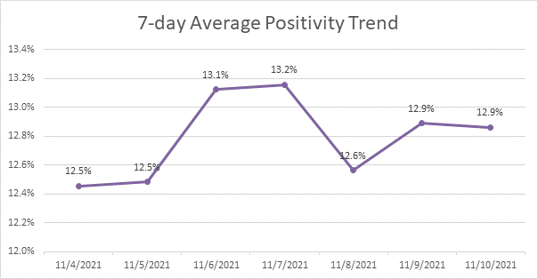
COVID-19 lab testing updates through 11/10/21
Date | Total Tests Resulted | Total Positive | Daily Positivity Rate
11/4/2021 | 418 | 50 | 12.0%
11/5/2021 | 420 | 54 | 12.9%
11/6/2021 | 220 | 31 | 14.1%
11/7/2021 | 230 | 31 | 13.5%
11/8/2021 | 495 | 51 | 10.3%
11/9/2021 | 396 | 59 | 14.9%
11/10/2021 | 474 | 59 | 12.4%
Notes:
Connie

Slide 8
COVID-10 Vaccine Doses Administered
First Doses | Second Doses | Booster Doses
136,538 | 114,564 | 10,807
Notes:
Connie

Slide 9
Hospital Incident Command System (HICS)
Notes:
Emma

Slide 10
Hospital Incident Command System
Model to assess, manage, and maintain a consistent response to emergency events
Provides a structured, formalized approach to response developed using lessons learned and best practices
Scalable
Increases culture of emergency preparedness
Notes:
ICS has been around since the 1970s. HICS became popular about 20 years later, mostly in areas familiar with wildland fires and comfortable with the use of ICS. After the 9/11 attacks, the federal government implemented the National Incident Management System (NIMS), which incorporates ICS. Since then, HICS has become much more common across the nation and worldwide.

Slide 11
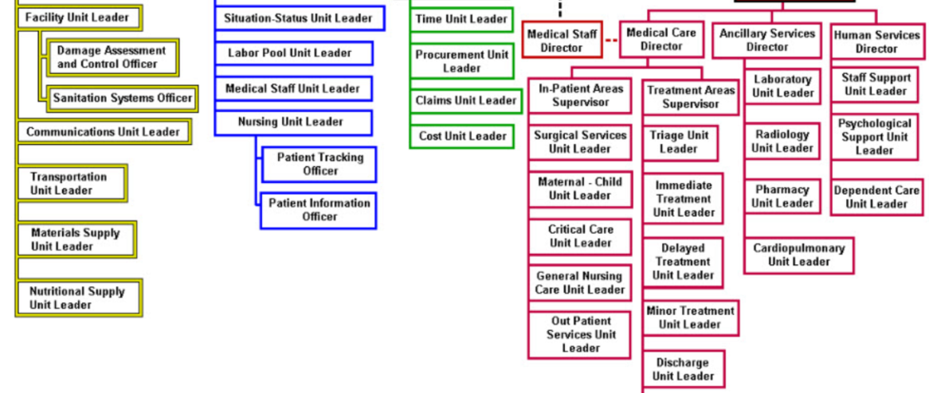
Hospital Incident Command System
A top-down, modular fashion that is based on the size and complexity of the incident
Incident objectives and resource requirements determine structure
Includes a reporting structure to maintain span of control
Scalability
Phase in and phase out use of HICS roles to manage a situation
Can be as simple or complexity as you need based on the size, scope, and complexity of the incident
Notes:
Only those functions or positions necessary for a particular incident are filled.
Benefits of HICS
Develop a command structure that eliminates duplication, can be scaled to fit the needs of the incident, and follows a reasonable span of control (bigger incidents need more leaders)
Integrate people from different parts of the hospital and from outside agencies into the command structure
Identify needs and establish objectives to resolve the incident
Develop strategies to achieve the objectives
Provide support and direction to those responsible for carrying out the objectives (the tactical response)

Slide 12
Reactivation of Incident Command
COVID and COVID-adjacent factors…

Slide 13
Reactivation of Incident Command
Internal Factors
Staffing challenges across the organization
Steady increase in COVID-19 + admissions
External Factors
Regional-wide ED Divert
Community spread of COVID and increased transmission
Local, regional, national, and international supply chain challenges
Executive orders from Governor Polis
Notes:
What prompted us to reactivate incident command…

Slide 14
Executive Orders
Executive Order D 2021 135 – Transfers
This order essentially gives authority to a group (CHTC) to support and facilitate transfers
Similar to the 2020 order that provided the same authority to CDPHE, the expectation is that CDPHE will delegate to CHTC
Order also addresses insurance implications for transfers out of network, etc.
This order likely applies to only inter-facility transfers and not initial calls for service (initial EMS transports)
Executive Order D 2021 136 - CSC and Staffing
This order lays the groundwork for the Governor's Expert Emergency Epidemic Response Committee (GEEERC) to activate Colorado’s Crisis Standards of Care
CDC were reactivated by Dr. Eric France, CMO for CDPHE on 11/9/21
Notes:
Issued by Governor Polis on Sunday 10/31
Governor's Expert Emergency Epidemic Response Committee (GEEERC).
The CSC for staffing outlines several categories of staffing response (e.g., staff and supply planning, health care worker roles, alternative staffing models) at a conventional level, contingency level, and crisis level, as well as triggers that would move an organization from conventional to contingency to crisis.

Slide 15
Public Health Orders
Public Health Order 20-38 is extended
The Order includes limited requirements to mitigate the spread of COVID-19 in Colorado.
It requires face coverings in some settings.
The Order also includes hospital reporting requirements to provide the State with critical information to assess the statewide capacity to provide necessary medical care and services to Coloradans.
Public Health Order 21-02
Aims to give hospitals greater capacity to serve Coloradans during the pandemic. It requires hospitals, hospital-owned Ambulatory Surgical Centers, and outpatient surgery centers to delay cosmetic procedures for up to six months if the delay would not cause harm to life, limb or function.
Notes:
Issued by Governor Polis on Sunday 10/31

Slide 16
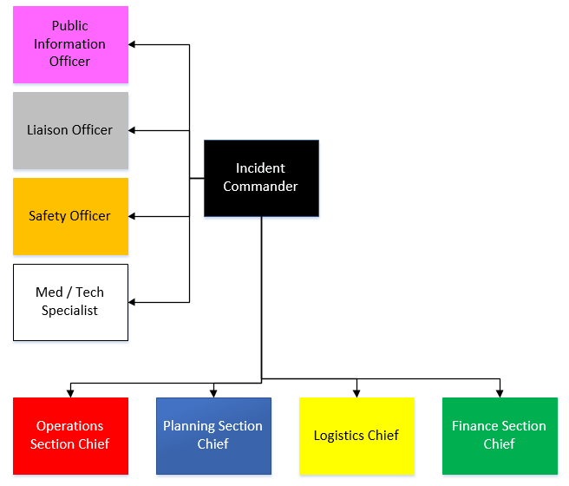
HICS at DHHA

Slide 17
HICS at DHHA
“Time is the most perishable commodity in an emergency.”
It is much easier to “turn things off than to catch up” during response.
-Craig Fugate, FEMA Administrator 2009-2017
Notes:
Why we use HICS and the advantages of an Incident Command Team…

Slide 18
Advantages of an Incident Command Team
Focus on the incident
Creates synergy and accountability
Coordinated flow for communications, and integrated information & intelligence management
Ensures there isn’t a duplication of efforts or conversely, gaps in response
Ensures appropriate roles are filled while preventing waste in resources
Allows us to respond to things we expect and things we may not have anticipated

Slide 19
Incident Command Team
Objectives for this activation → Lean into normal operations
Identify unmet staffing needs, convene a labor pool for internal supplementation of needed roles, and make external requests to manage gaps
Receive update and any known impacts from vaccine mandate deadline
Align DHHA operations with requirements set in E.O.s signed by Governor Polis
Review COVID volumes and address any direct known impacts to beds & services
Prepare for implementation of Crisis Standards of Care
Additionally, we want to ensure comprehensive and clear communications are provided internally and externally.

Slide 20
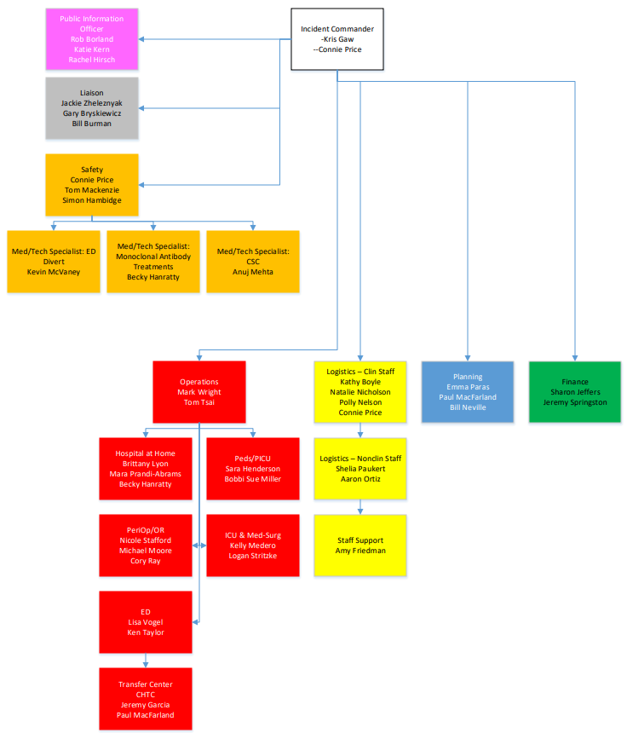
Incident Command Team
HICS Roles Activated

Slide 21
Questions
Post your questions in the Comments section!

