Slide 1

Continuing Medical Education (CME)
at Denver Health
Activity Chair & Faculty Training
Please download this file for the best user experience.

Slide 2
Planning Effective Continuing Medical Education (CME) Activities at Denver Health
A Step-by-Step Guide for Faculty and Planners

Slide 3
The Value of Accredited Education
Designed to meet physician needs and support practice-based improvement¹
Supports requirements for MOL, MOC, credentialing, and professional membership¹
Provides protected, unbiased space for learning and teaching¹
Demonstrates measurable impact on physician performance and patient outcomes²
Applies across clinical care, research, administration, and leadership¹
¹ ACCME. (n.d.). Why accredited CME matters. Retrieved from http://accme.org/why-accredited-CME-matters
² Cervero, R. M., & Gaines, J. K. (2015). The impact of CME on physician performance and patient health outcomes: An updated synthesis of systematic reviews. Journal of Continuing Education in the Health Professions, 35(2), 131-138. DOI: 10.1002/chp.21290

Slide 4
AMA PRA Category 1 Credit™: What to Know
Designated only by ACCME-accredited providers
Physicians claim credit; all other learners participate
Recognized by many non-physician associations
Colorado requirement (2024): 30 CME hours every 24 months for all physicians

Slide 5
The Content Development Process
Identify Practice Gaps and Educational Needs
Define
Target Audience
Develop Learning Objectives
Create Content Aligned with Needs, Audience, & Objectives
Assess Activity Impact on Learning
Classify Gaps: Competence, Performance, or Knowledge

Slide 6

Required Activity Files
Completed CME Intake Form
Completed Conflict of Interest (COI) Forms
Marketing materials
Presentations/content
  MUST include introductory information displaying faculty/planner disclosures and commercial support statements
Completed Commercial Support Form(s) (if applicable) including documentation of receipt and expenditure of funds
Activity attendee list
Budget actuals
Send ALL to continuing_education@dhha.org

Slide 7
Why We Need This Information
Required for annual and reaccreditation reporting
Keeps activities aligned with accredited provider standards
Documents how activities are planned, implemented, and evaluated
Protects required attendee records for the 6-year retention period

Slide 8
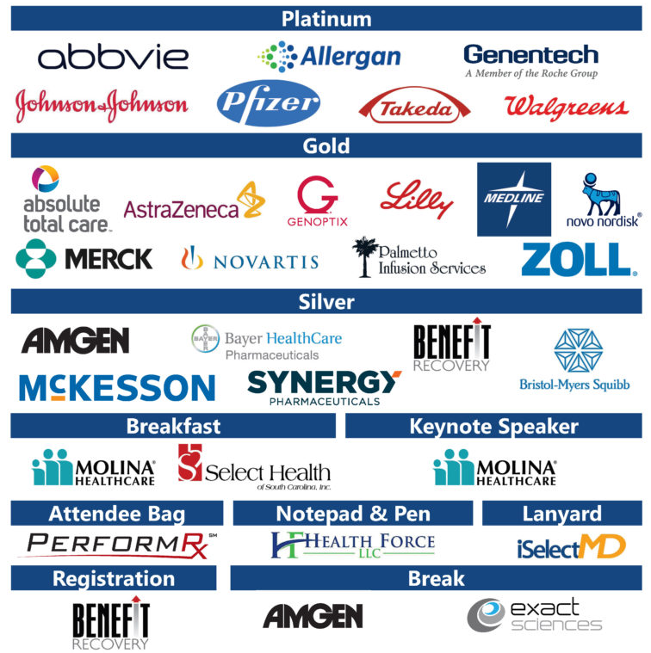
Commercial support
Early coordination with the Office of Education is required for activities with exhibitors, sponsors, or grants, as it impacts:
Conflict of interest management
Marketing and communications
Educational materials and disclosures
On-site learner engagement

Slide 9

CME Activity Steps
C = Chair │ F = Faculty (Chairs: you are likely both!)
C
F
Briefly document professional practice gaps and educational needs
Identify target learners
Select planning committee
Develop learning objectives and determine activity format
Complete CME Intake Form
Convene planning committee to determine faculty
Complete and return Conflict of Interest (COI) Form
Submit slides or content outline
(Optional) Submit pre- and post-test questions
Approve evaluation and final pre/post questions
(Optional) Participate in a brief pre- or post-activity call with the CE office
Work with faculty to outline and assign content development
C
C
C
C
Click first box to begin
C/F
C/F
C
C
Multi-day conference? Commercial support? We may require more advance notice than 6 weeks
F
F
C
C/F

Slide 10
Educational Gaps and Needs
DEFINITION
The difference between health care processes or outcomes observed in practice, and those potentially achievable on the basis of current professional knowledge. These are often:
Click on each circle below for an example
Quality concerns in the department
Outdated practices or procedures
Unfamiliarity with updated standards
Insufficient knowledge of disease developments
Failure to meet unique patient population needs
Difference between actual and ideal learner performance or patient outcomes
One unit shows high catheter infection rates due to inconsistent infection control practices.
Clinicians are still prescribing older antibiotics for pneumonia instead of following new first-line recommendations.
Only 56% of physicians can safely discontinue cognitive medications for end-stage dementia while managing behaviors.
Staff aren’t documenting blood pressure readings according to current CMS requirements.
Physicians continue ordering daily labs for stable patients despite updated guidelines.
Elderly patients with dementia are discharged without proper medication reconciliation, leading to complications.

Slide 11
CME Activity Steps
C = Chair │ F = Faculty (Chairs: you are likely both!)
C
F
Click next section to continue
Briefly document professional practice gaps and educational needs
Identify target learners
Select planning committee
Develop learning objectives and determine activity format
Complete CME Intake Form
Convene planning committee to determine faculty
Complete and return Conflict of Interest (COI) Form
Submit slides or content outline
(Optional) Submit pre- and post-test questions
Approve evaluation and final pre/post questions
(Optional) Participate in a brief pre- or post-activity call with the CE office
Work with faculty to outline and assign content development
C
C
C
C
C/F
C/F
C
C
Multi-day conference? Commercial support? We may require more advance notice than 6 weeks
F
F
C
C/F

Slide 12

Target Learners
EXAMPLE
This activity is targeted for primary care physicians, advanced practice providers, and nurses who manage patients with end stage dementia

Slide 13
CME Activity Steps
C = Chair │ F = Faculty (Chairs: you are likely both!)
C
F
Click next section to continue
Briefly document professional practice gaps and educational needs
Identify target learners
Select planning committee
Develop learning objectives and determine activity format
Complete CME Intake Form
Convene planning committee to determine faculty
Complete and return Conflict of Interest (COI) Form
Submit slides or content outline
(Optional) Submit pre- and post-test questions
Approve evaluation and final pre/post questions
(Optional) Participate in a brief pre- or post-activity call with the CE office
Work with faculty to outline and assign content development
C
C
C
C
C/F
C/F
C
C
Multi-day conference? Commercial support? We may require more advance notice than 6 weeks
F
F
C
C/F

Slide 14
Planning Committee
The planning committee should represent your target learners. If your target is primary care physicians, advanced practice providers, and nurses, the planning committee should include at least one of each.

Slide 15
CME Activity Steps
C = Chair │ F = Faculty (Chairs: you are likely both!)
C
F
Click next section to continue
Briefly document professional practice gaps and educational needs
Identify target learners
Select planning committee
Develop learning objectives and determine activity format
Complete CME Intake Form
Convene planning committee to determine faculty
Complete and return Conflict of Interest (COI) Form
Submit slides or content outline
(Optional) Submit pre- and post-test questions
Approve evaluation and final pre/post questions
(Optional) Participate in a brief pre- or post-activity call with the CE office
Work with faculty to outline and assign content development
C
C
C
C
C/F
C/F
C
C
Multi-day conference? Commercial support? We may require more advance notice than 6 weeks
F
F
C
C/F

Slide 16
Activity Format
AMA-recognized CME formats include:
Live: Conferences, workshops, and webinars conducted in real time
Enduring: On-demand courses, recorded webinars, and other lasting materials
Journal-Based: Activities linked to peer-reviewed journal articles
Performance Improvement (PI CME): Projects to enhance clinical practice and patient outcomes
Manuscript Review: Critical evaluation of submitted research for educational credit

Slide 17
Learning Objectives
Learning objectives must be measurable and attainable.
EXAMPLE
At the conclusion of this activity, the participant should be able to:
Click to Reveal
Identify criteria for safely discontinuing medications in end-stage Dementia.
Apply evidence-based approaches to minimize behavioral complications.
Click to Reveal

Slide 18
CME Activity Steps
C = Chair │ F = Faculty (Chairs: you are likely both!)
C
F
Click next section to continue
Briefly document professional practice gaps and educational needs
Identify target learners
Select planning committee
Develop learning objectives and determine activity format
Complete CME Intake Form
Convene planning committee to determine faculty
Complete and return Conflict of Interest (COI) Form
Submit slides or content outline
(Optional) Submit pre- and post-test questions
Approve evaluation and final pre/post questions
(Optional) Participate in a brief pre- or post-activity call with the CE office
Work with faculty to outline and assign content development
C
C
C
C
C/F
C/F
C
C
Multi-day conference? Commercial support? We may require more advance notice than 6 weeks
F
F
C
C/F

Slide 19
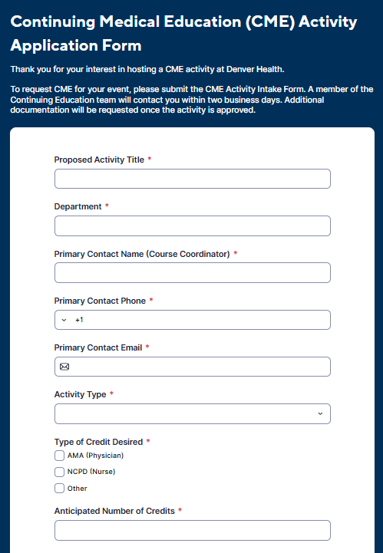
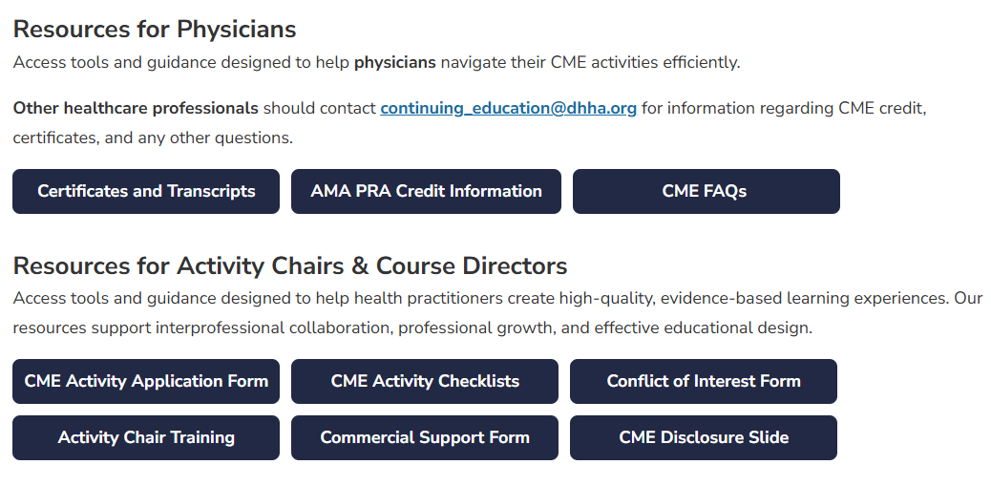
CME Intake Form
Access the CME Activity Application Form
Complete the CME Activity Form for your activity
Find the form on the Denver Health Office of Education CME Website under “Resources”

Slide 20
CME Activity Steps
C = Chair │ F = Faculty (Chairs: you are likely both!)
C
F
Click next section to continue
Briefly document professional practice gaps and educational needs
Identify target learners
Select planning committee
Develop learning objectives and determine activity format
Complete CME Intake Form
Convene planning committee to determine faculty
Complete and return Conflict of Interest (COI) Form
Submit slides or content outline
(Optional) Submit pre- and post-test questions
Approve evaluation and final pre/post questions
(Optional) Participate in a brief pre- or post-activity call with the CE office
Work with faculty to outline and assign content development
C
C
C
C
C/F
C/F
C
C
Multi-day conference? Commercial support? We may require more advance notice than 6 weeks
F
F
C
C/F

Slide 21
Determine Faculty
Just as the planning committee represents your target learners, faculty should have the content expertise to help learners attain each of the learning objectives.

Slide 22
CME Activity Steps
C = Chair │ F = Faculty (Chairs: you are likely both!)
C
F
Click next section to continue
Briefly document professional practice gaps and educational needs
Identify target learners
Select planning committee
Develop learning objectives and determine activity format
Complete CME Intake Form
Convene planning committee to determine faculty
Complete and return Conflict of Interest (COI) Form
Submit slides or content outline
(Optional) Submit pre- and post-test questions
Approve evaluation and final pre/post questions
(Optional) Participate in a brief pre- or post-activity call with the CE office
Work with faculty to outline and assign content development
C
C
C
C
C/F
C/F
C
C
Multi-day conference? Commercial support? We may require more advance notice than 6 weeks
F
F
C
C/F

Slide 23
Conflict of Interest (COI) Form
Access the COI Form
Required for all planners, faculty, and speakers
Anyone involved in shaping content must disclose relevant financial relationships
Ensures CME compliance and accreditation
Access the form on the Denver Health CME Website → “Resources”

Slide 24
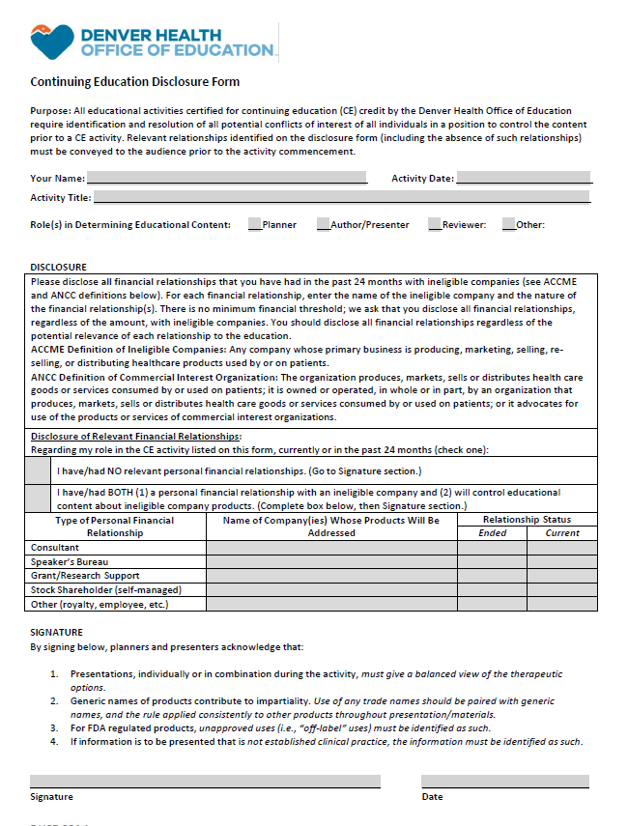
COI Form (Contd.)
What is a Financial Relationship?
A financial relationship exists when you have BOTH:
A personal financial relationship (any amount) with a commercial interest in the past 24 months, whether current or ended
Control in planning or presenting educational content that addresses specific products of that commercial interest (not just a product category)

Slide 25
CME Activity Steps
C = Chair │ F = Faculty (Chairs: you are likely both!)
C
F
Click next section to continue
Briefly document professional practice gaps and educational needs
Identify target learners
Select planning committee
Develop learning objectives and determine activity format
Complete CME Intake Form
Convene planning committee to determine faculty
Complete and return Conflict of Interest (COI) Form
Submit slides or content outline
(Optional) Submit pre- and post-test questions
Approve evaluation and final pre/post questions
(Optional) Participate in a brief pre- or post-activity call with the CE office
Work with faculty to outline and assign content development
C
C
C
C
C/F
C/F
C
C
Multi-day conference? Commercial support? We may require more advance notice than 6 weeks
F
F
C
C/F

Slide 26
Plan & Assign Content Development
Assign Content to Faculty
Work with faculty to outline content for their presentations
Ensure content aligns with the overall learning objectives and targets the appropriate learners
Faculty may add presentation-specific learning objectives to the first slides of their talk
Confirm that each faculty member understands how their content contributes to the overall activity

Slide 27
Plan & Assign Content Development (contd.)
Click on a learning objective on the left to match it with the type of objective on the right.
Example: Evaluate at what point medicine should be discontinued for patients with end-stage dementia, according to diagnostic criteria.
Overall Learning Objective
Example: Describe recent changes in diagnostic criteria that impact evaluation of medicine discontinuation.
Presenter-specific Learning Objective

Slide 28
CME Activity Steps
C = Chair │ F = Faculty (Chairs: you are likely both!)
C
F
Click next section to continue
Briefly document professional practice gaps and educational needs
Identify target learners
Select planning committee
Develop learning objectives and determine activity format
Complete CME Intake Form
Convene planning committee to determine faculty
Complete and return Conflict of Interest (COI) Form
Submit slides or content outline
(Optional) Submit pre- and post-test questions
Approve evaluation and final pre/post questions
(Optional) Participate in a brief pre- or post-activity call with the CE office
Work with faculty to outline and assign content development
C
C
C
C
C/F
C/F
C
C
Multi-day conference? Commercial support? We may require more advance notice than 6 weeks
F
F
C
C/F

Slide 29
Submit PowerPoints or Content Outline
All slides or content outlines must be submitted to the CME office before the activity
Ensure content is aligned with learning objectives, target audience, and identified gaps
Include any presentation-specific learning objectives on the first slides

Slide 30
Presentation Content Requirements
Click each box to review the standard
Show a fair and balanced view of treatment options. Don’t favor or promote any product.
Product Mentions
Balance & Bias
Use generic drug names.
If brand names are necessary, list the generic first, followed by the brand in parentheses.
Ex. Acetaminophen (Tylenol)
Scientific Standards
Get permission for copyrighted materials. Faculty are ultimately responsible for their content.
Present facts from reliable sources (peer-reviewed studies). Note if any use is not FDA-approved
Copyright & Permissions

Slide 31
CME Activity Steps
C = Chair │ F = Faculty (Chairs: you are likely both!)
C
F
Click next section to continue
Briefly document professional practice gaps and educational needs
Identify target learners
Select planning committee
Develop learning objectives and determine activity format
Complete CME Intake Form
Convene planning committee to determine faculty
Complete and return Conflict of Interest (COI) Form
Submit slides or content outline
(Optional) Submit pre- and post-test questions
Approve evaluation and final pre/post questions
(Optional) Participate in a brief pre- or post-activity call with the CE office
Work with faculty to outline and assign content development
C
C
C
C
C/F
C/F
C
C
Multi-day conference? Commercial support? We may require more advance notice than 6 weeks
F
F
C
C/F

Slide 32
Pre/Post Test Question Guidelines
Next Step:
Follow detailed question writing guidelines on next slide
Best Practices:
Use mini case studies whenever possible to measure application of the content
Submission:
Send to CE office with correct answer highlighted and a brief explanation
Format:
Multiple choice with 4–5 answer options
Number of Questions:
2–3 for a 1-hour session within a larger conference
Number of Questions:
4-5 questions for a single one-hour activity

Slide 33
Pre/Post Test Question Best Practices
Click on any part of the question or answer options to improve it. When you click, a corrected version appears (three total).
A 30-year-old woman presents with balance problems. MRI scan reveals an eccentric lesion at C4 with hyperintensity on T2-weighted images and no contrast enhancement.
A woman comes in with dizziness and trouble walking. MRI shows a weird lesion at C4.
Which of the following is not the correct diagnosis?:
What is the most likely diagnosis?
Astrocytoma
Tip: Include as much information as possible in the stem; stems should be long, options short.
Ependymoma
Multiple sclerosis
Tip: Avoid negative phrasing in stems. Reword question neutrally.
Infection
None of the Above
Tip: Avoid ‘None of the above’ or ‘All of the above’ as answer options

Slide 34
CME Activity Steps
C = Chair │ F = Faculty (Chairs: you are likely both!)
C
F
Click next section to continue
Briefly document professional practice gaps and educational needs
Identify target learners
Select planning committee
Develop learning objectives and determine activity format
Complete CME Intake Form
Convene planning committee to determine faculty
Complete and return Conflict of Interest (COI) Form
Submit slides or content outline
(Optional) Submit pre- and post-test questions
Approve evaluation and final pre/post questions
(Optional) Participate in a brief pre- or post-activity call with the CE office
Work with faculty to outline and assign content development
C
C
C
C
C/F
C/F
C
C
Multi-day conference? Commercial support? We may require more advance notice than 6 weeks
F
F
C
C/F

Slide 35
Evaluations
Click clipboard to reveal
An evaluation for each activity will be provided to you by the CE Office via Qualtrics.
If you’d like to make changes to the evaluation, please connect with the CE office before sending to attendees.
For post-test questions, the CE office will include logic that represents the correct response & rationale.

Slide 36
CME Activity Steps
C = Chair │ F = Faculty (Chairs: you are likely both!)
C
F
Click next section to continue
Briefly document professional practice gaps and educational needs
Identify target learners
Select planning committee
Develop learning objectives and determine activity format
Complete CME Intake Form
Convene planning committee to determine faculty
Complete and return Conflict of Interest (COI) Form
Submit slides or content outline
(Optional) Submit pre- and post-test questions
Approve evaluation and final pre/post questions
(Optional) Participate in a brief pre- or post-activity call with the CE office
Work with faculty to outline and assign content development
C
C
C
C
C/F
C/F
C
C
Multi-day conference? Commercial support? We may require more advance notice than 6 weeks
F
F
C
C/F

Slide 37
Optional: Pre-activity Call (≥1 day before)
The chair, faculty, and planners meet with the CE office to review:
Outstanding information needed for the activity
Protocol for last-minute content changes
Housekeeping slides (chair/designated faculty)
Logistics (room setup, presentation times, sign-in)
Evaluation and post-test administration
CME credit awarding process

Slide 38
REQUIRED: CME Quiz
Please take our 2-minute CME Quiz to confirm your completion of the course.
Advance to the next slide to begin the quiz or ACCESS HERE

Slide 39


